Slide 1
REAL TIME EDGE DETECTION -CANNY
TEAM MEMBERS: VISHAL(RA2111026010418)
DINESH KUMAR(RA2111026010422)
KURSHITH(RA2111026010417)
SOORYA(RA2111026010377)

Slide 2
INTRODUCTION TO EDGE DETECTION-CANNY:
The Canny edge detector is an edge detection operator that uses a multi-stage algorithm to detect a wide range of edges in images. It was developed by John F. Canny in 1986. Canny also produced a computational theory of edge detection explaining why the technique works.
Canny edge detection is a technique to extract useful structural information from different vision objects and dramatically reduce the amount of data to be processed. It has been widely applied in various computer vision systems. Canny has found that the requirements for the application of edge detection on diverse vision systems are relatively similar. Thus, an edge detection solution to address these requirements can be implemented in a wide range of situations.

Slide 3
The general criteria for edge detection include:
Detection of edge with low error rate, which means that the detection should accurately catch as many edges shown in the image as possible
The edge point detected from the operator should accurately localize on the center of the edge.
A given edge in the image should only be marked once, and where possible, image noise should not create false edges.

Slide 4
The Canny edge detection algorithm is composed of 5 steps:
Noise reduction;
Gradient calculation;
Non-maximum suppression;
Double threshold; Image thresholding is a simple, yet effective, way of partitioning an image into a foreground and background. This image analysis technique is a type of image segmentation that isolates objects by converting grayscale images into binary images.
Edge Tracking by Hysteresis.
The most powerful edge-detection method that edge provides is the Canny method. The Canny method differs from the other edge-detection methods in that it uses two different thresholds (to detect strong and weak edges), and includes the weak edges in the output only if they are connected to strong edges

Slide 5
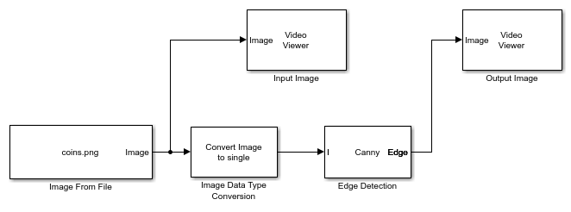
ALGORITHM
.

Slide 6
CODE FOR REAL TIME EDGE DETECTION USING WEBCAM IN CANNY OPERATION(MATLAB):
clc
clear all
close all
warning off
c=webcam;
while true
x=c.snapshot;
imshow(x);
a=rgb2gray(x);
subplot(1,2,1);
imshow(x);
title('Original Image');
w=edge(a,'canny');
subplot(1,2,2);
imshow(w);
title('Canny Operation');
end

Slide 7
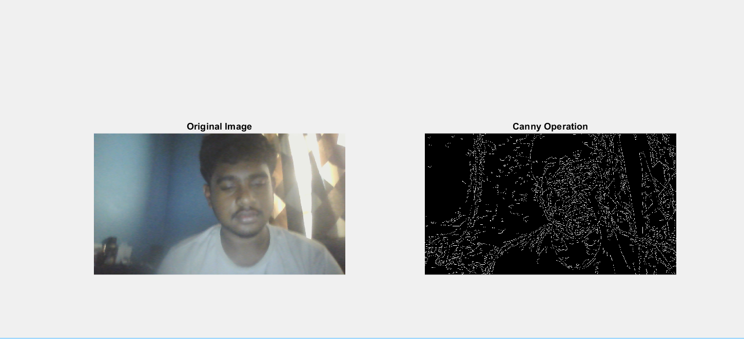
INPUT AND OUTPUT:

Slide 8
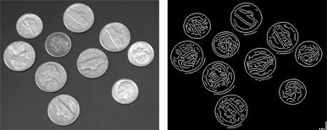
ANOTHER EXAMPLE OF CANNY EDGE DETECTION:
.

Slide 9
CONCLUSION:
So as we saw how the real time edge detection using canny method in matlab we can come to a conclusion why canny is better..Canny edge detection algorithm produces smoother, thinner, and cleaner images than Sobel and Prewitt filters. The input image is smoothened, Sobel filter is applied to detect the edges of the image.
The input image is captured with the webcam and output canny is also displayed.
THANK YOU

